Slide 1
Cloud Computing and Big Data Realtime Big Data
Oxford University
Software Engineering Programme
July 2018

Slide 2

Recap on the Lambda Architecture

Slide 3
Streaming
Continuous data flow
“Unbounded streams of data”
Usually uses a message distribution system
JMS
Apache Kafka
MQTT
Etc
An unbounded set of events with time
<t1, E1>, <t2, E2>, ….., <tn, En>, ....

Slide 4
Stream processing categorization
Simple event processing
Working on an event at a time
e.g. filter out all events where the wind speed > 50 mph
Event stream processing
Time-based processing of a single stream of events
Average wind speed over the last hour compared to the average over the last day
Complex Event Processing
Correlation of events across different streams
Emergency calls correlated with wind speed in real time

Slide 5


Comparing Databases with Real-Time systems
 | Database Applications | Event-driven Applications
Query Paradigm | Ad-hoc queries or requests | Continuous standing queries
Latency | Seconds, hours, days | Milliseconds or less
Data Rate | Hundreds of events/sec | Tens of thousands of events/sec or more
Event
output stream
request
input stream
response

Slide 6
Lambda Architecture

Slide 7
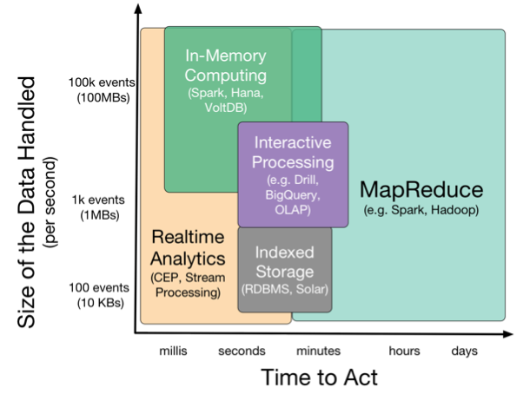

Slide 8
Approaches to Streaming
Pure streaming
Each event is processed as it comes in
Micro-batch
Small batches of events are processed
Typically trades flexibility for performance
Shared nothing
You can process events on any system in the cluster
Stateful / Partitioned
The event must be processed on a system that has the correct state in memory

Slide 9
Data distribution
You need to get the events to the processing systems

Slide 10
MQTT
Very simple, lightweight, fast
No built in support for clustering / big-data
But can make up for it by being very fast
Used a lot in IoT

Slide 11

Apache Kafka
Source: http://www.slideshare.net/charmalloc/

Slide 12
Kafka
Many of the approaches we’ve seen:
Partitioning
Multiple brokers
Elastically scalable
Supports clusters of co-ordinated consumers
Automatic re-election of leaders

Slide 13
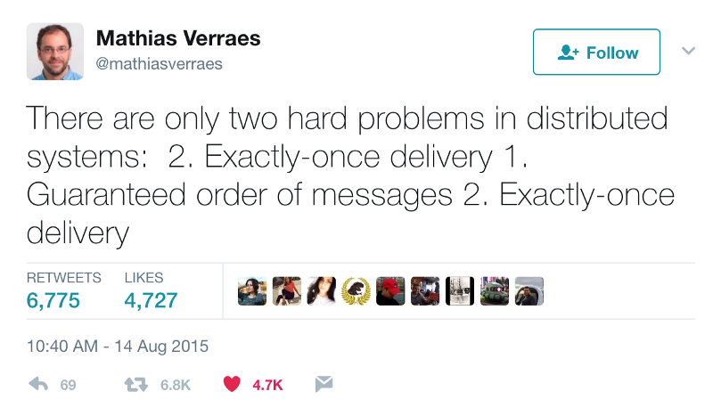
Kafka exactly-once semantics

Slide 14
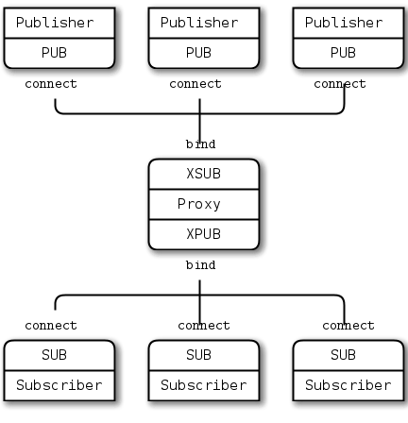
ZeroMQ

Slide 15
Processing the data

Slide 16

Apache Storm
Spout
Bolt
Bolt
Spout
Bolt
Note: another DAG

Slide 17
Apache Storm
Originally developed by BackType
Nathan Marz
Acquired by Twitter
Open Sourced and then donated to Apache
Became a top level project in 2014
http://storm.apache.org

Slide 18
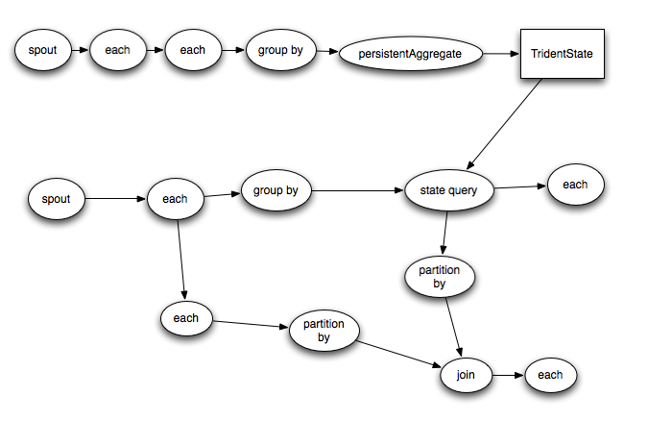
Apache Storm Trident (micro-batch)

Slide 19
Storm vs Spark Streaming
“Classic” Storm has no counterpart in Spark
Spouts and Bolts
Event by event processing
Trident and Streaming both offer micro-batch models
More performant but less flexible
Storm is more flexible for pure streaming systems
Spark offers a much more unified programming model for Batch and Streaming

Slide 20
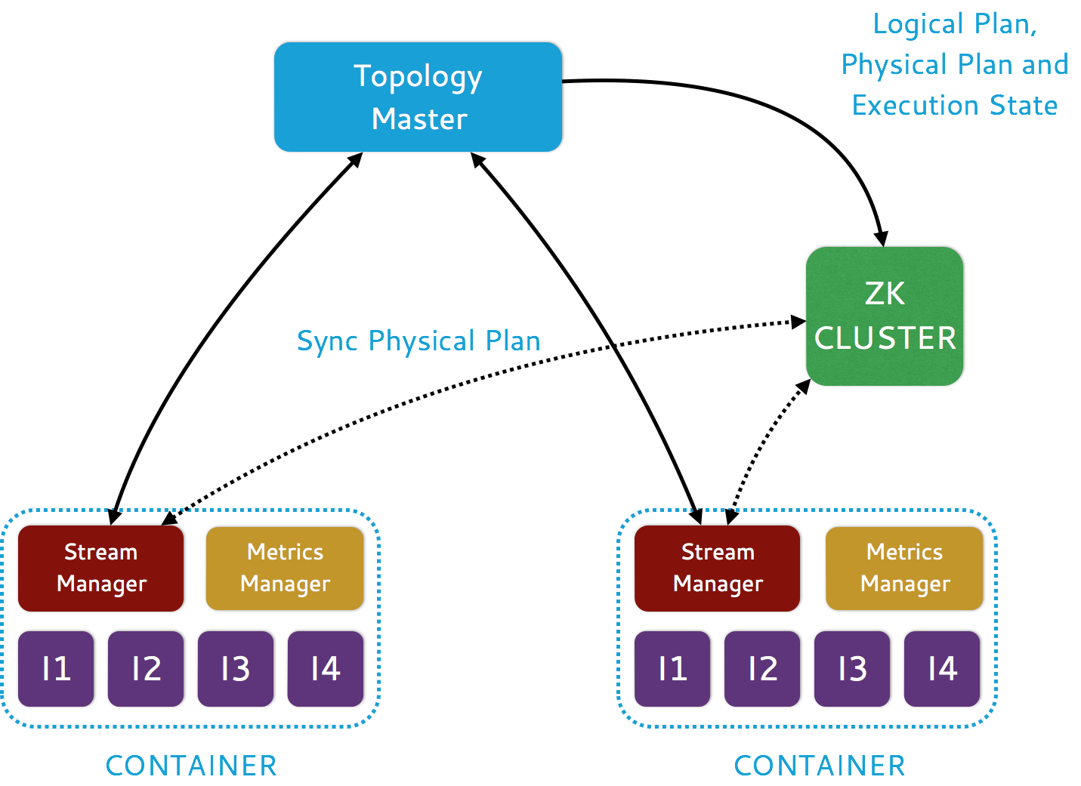
Heron

Slide 21
Heron: Key Features
Fully API compatible with Apache Storm
Task isolation
Developer productivity
Ease of manageability
Use of mainstream languages C++/Java/Python

Slide 22
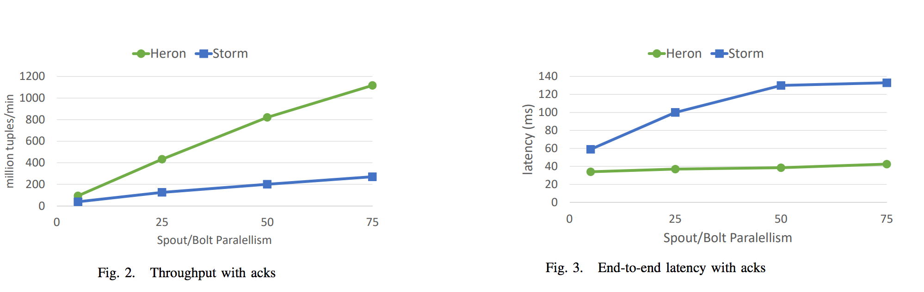
Heron
In production at Twitter for >2 years
Going into production at Microsoft, WeChat
Donation to CNCF

Slide 23
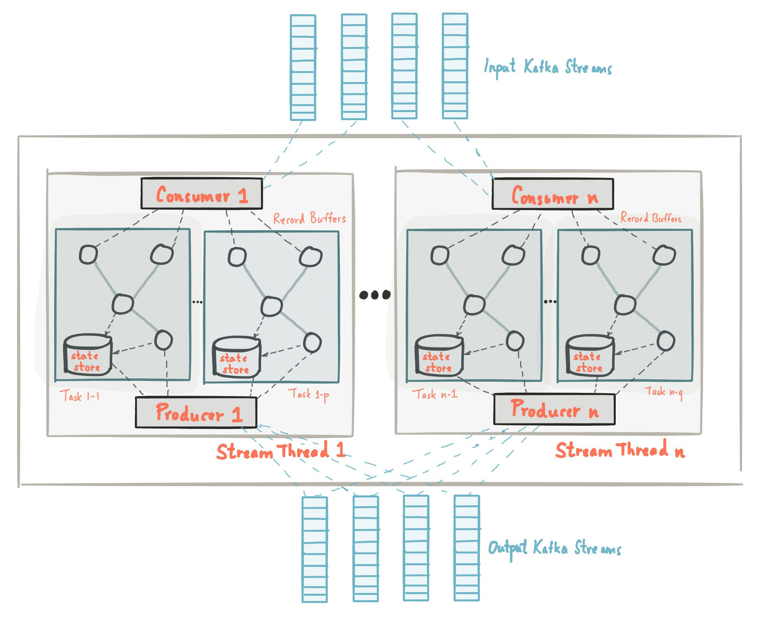
Kafka Streams

Slide 24
Kafka Streams
Event-at-a-time processing (not microbatch) with millisecond latency
Stateful processing including distributed joins and aggregations
A convenient DSL
Windowing with out-of-order data using a DataFlow-like model
Distributed processing and fault-tolerance with fast failover
Reprocessing capabilities so you can recalculate output when your code changes
No-downtime rolling deployments

Slide 25
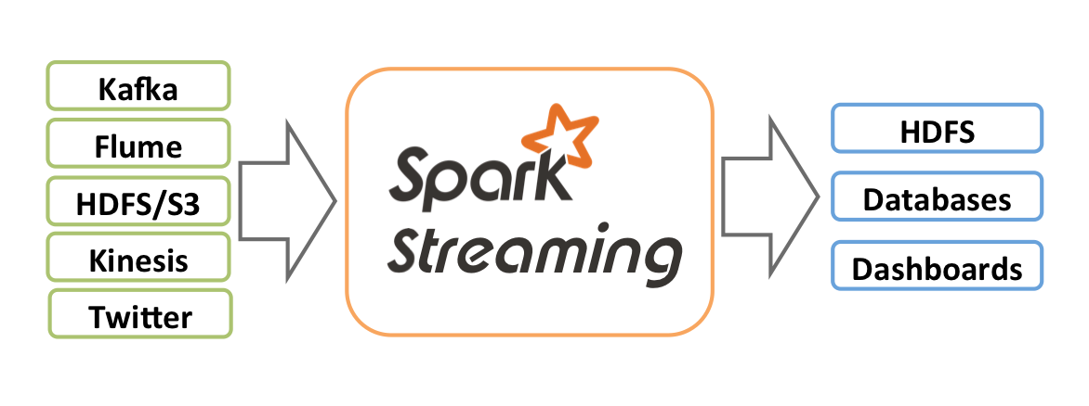
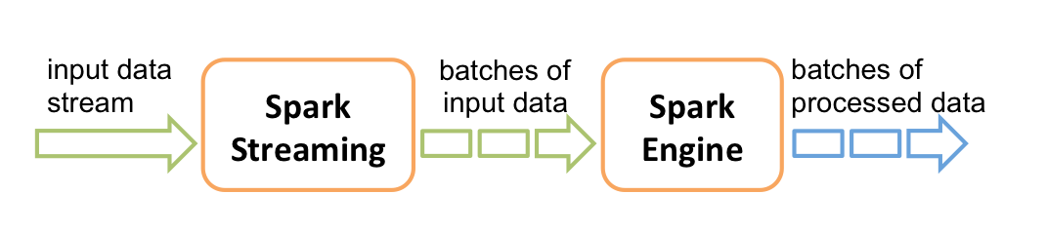
Apache Spark Streaming

Slide 26
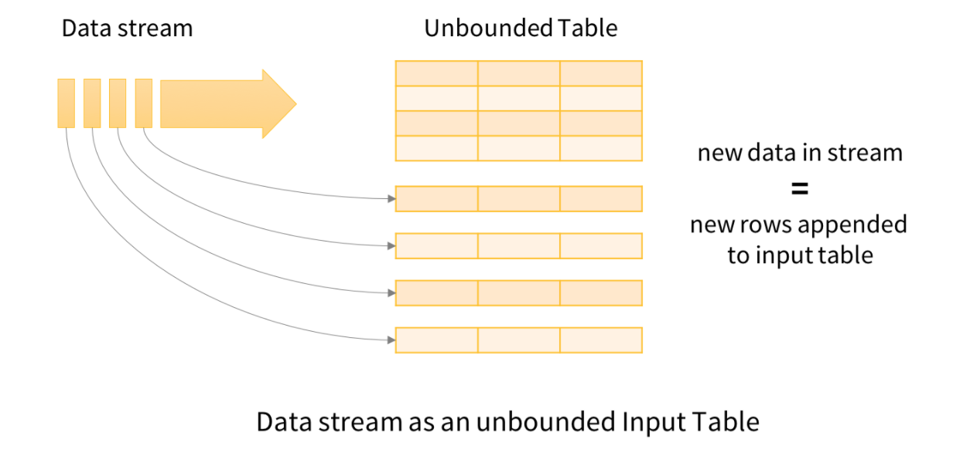
Structured Streams in Spark
Since Spark 2.0, there is a much better approach

Slide 27
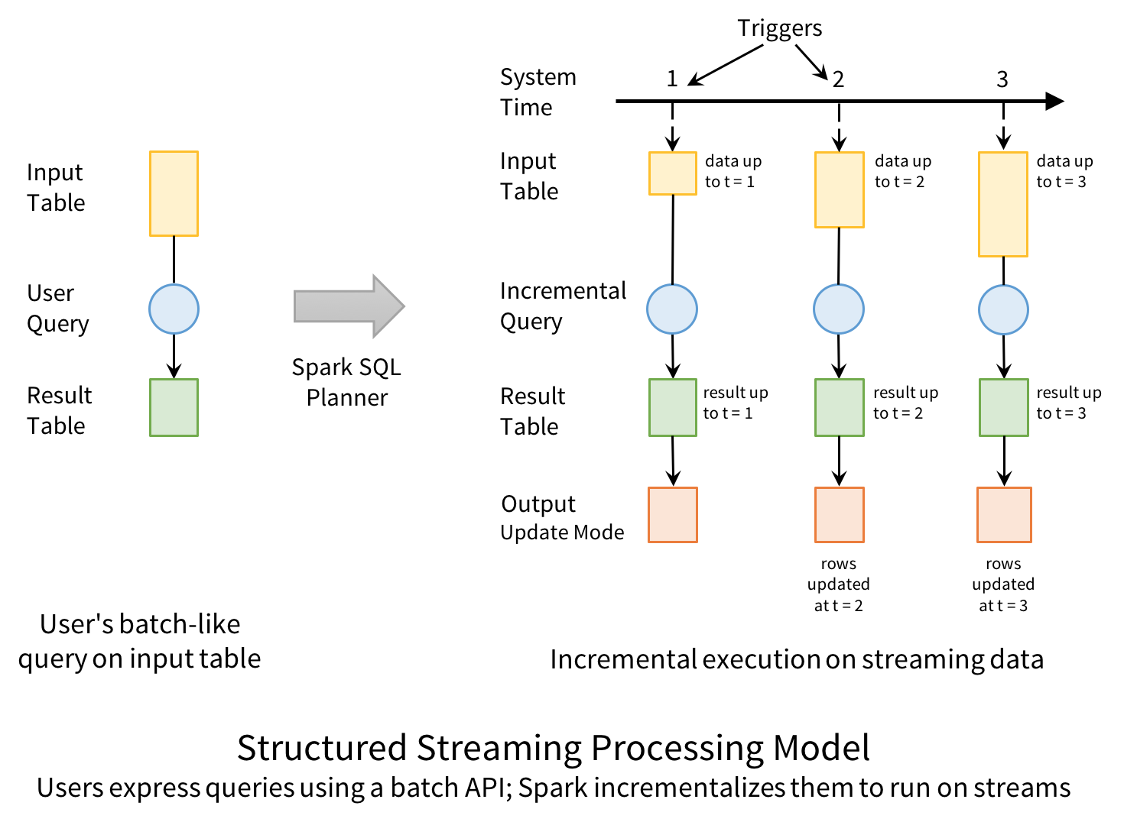

Slide 28
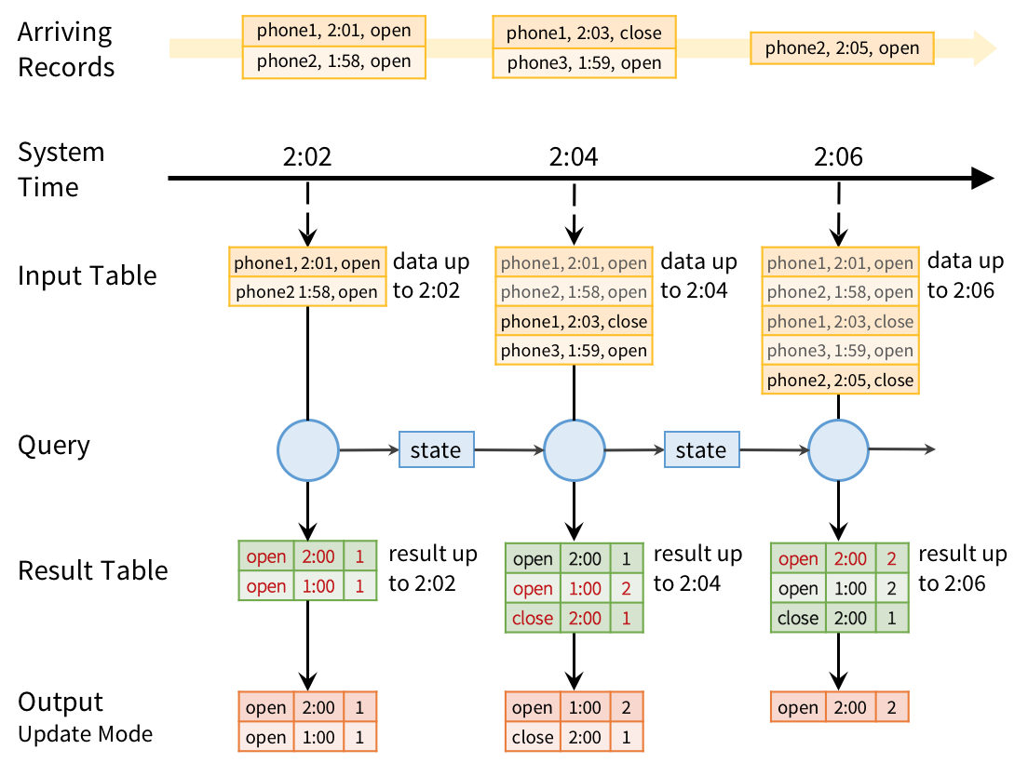

Slide 29
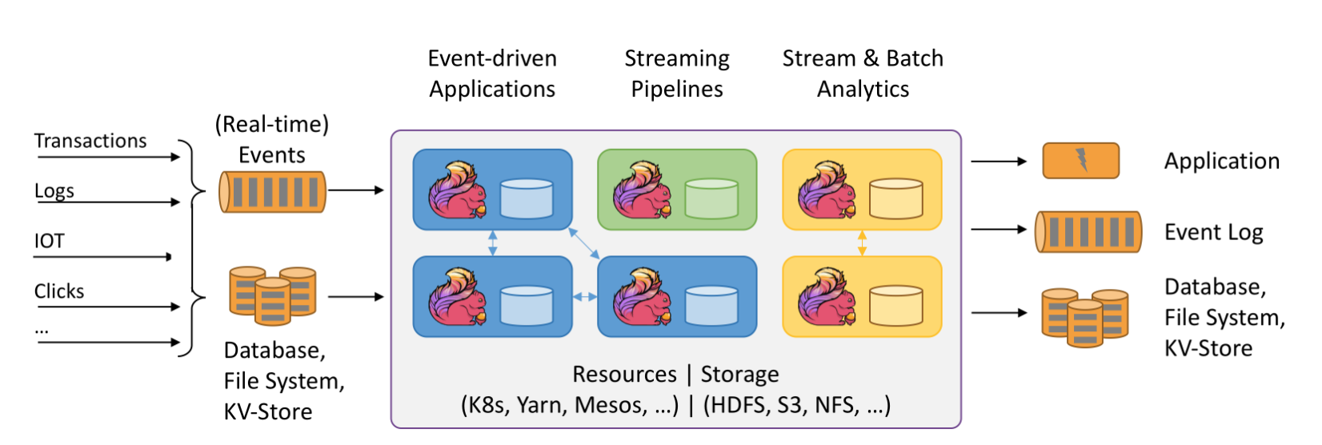
Apache Flink

Slide 30
Siddhi
A stateful query model
SQL-like language for querying streams of data
Extended with windows
Time, Event count, batches
Partitioned
Based on data in the events
Pattern matching
A then B then C within window

Slide 31
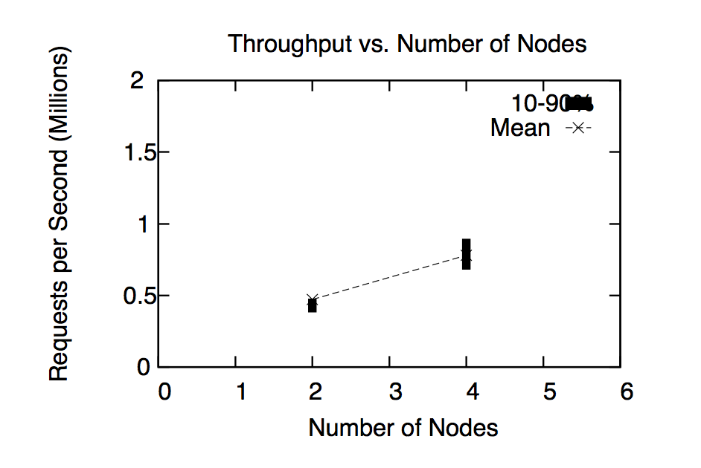
Siddhi
Apache Licensed Open Source on Github
https://github.com/wso2/siddhi/
Pluggable into Storm, Spark and Kafka Streams
Supports millions of events/sec
http://freo.me/DEBS_Siddhi

Slide 32
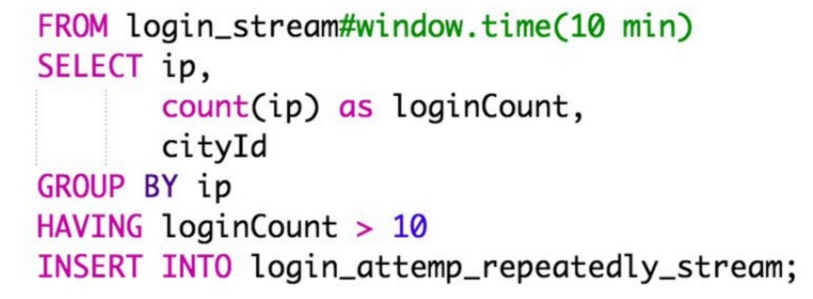
SiddhiQL

Slide 33
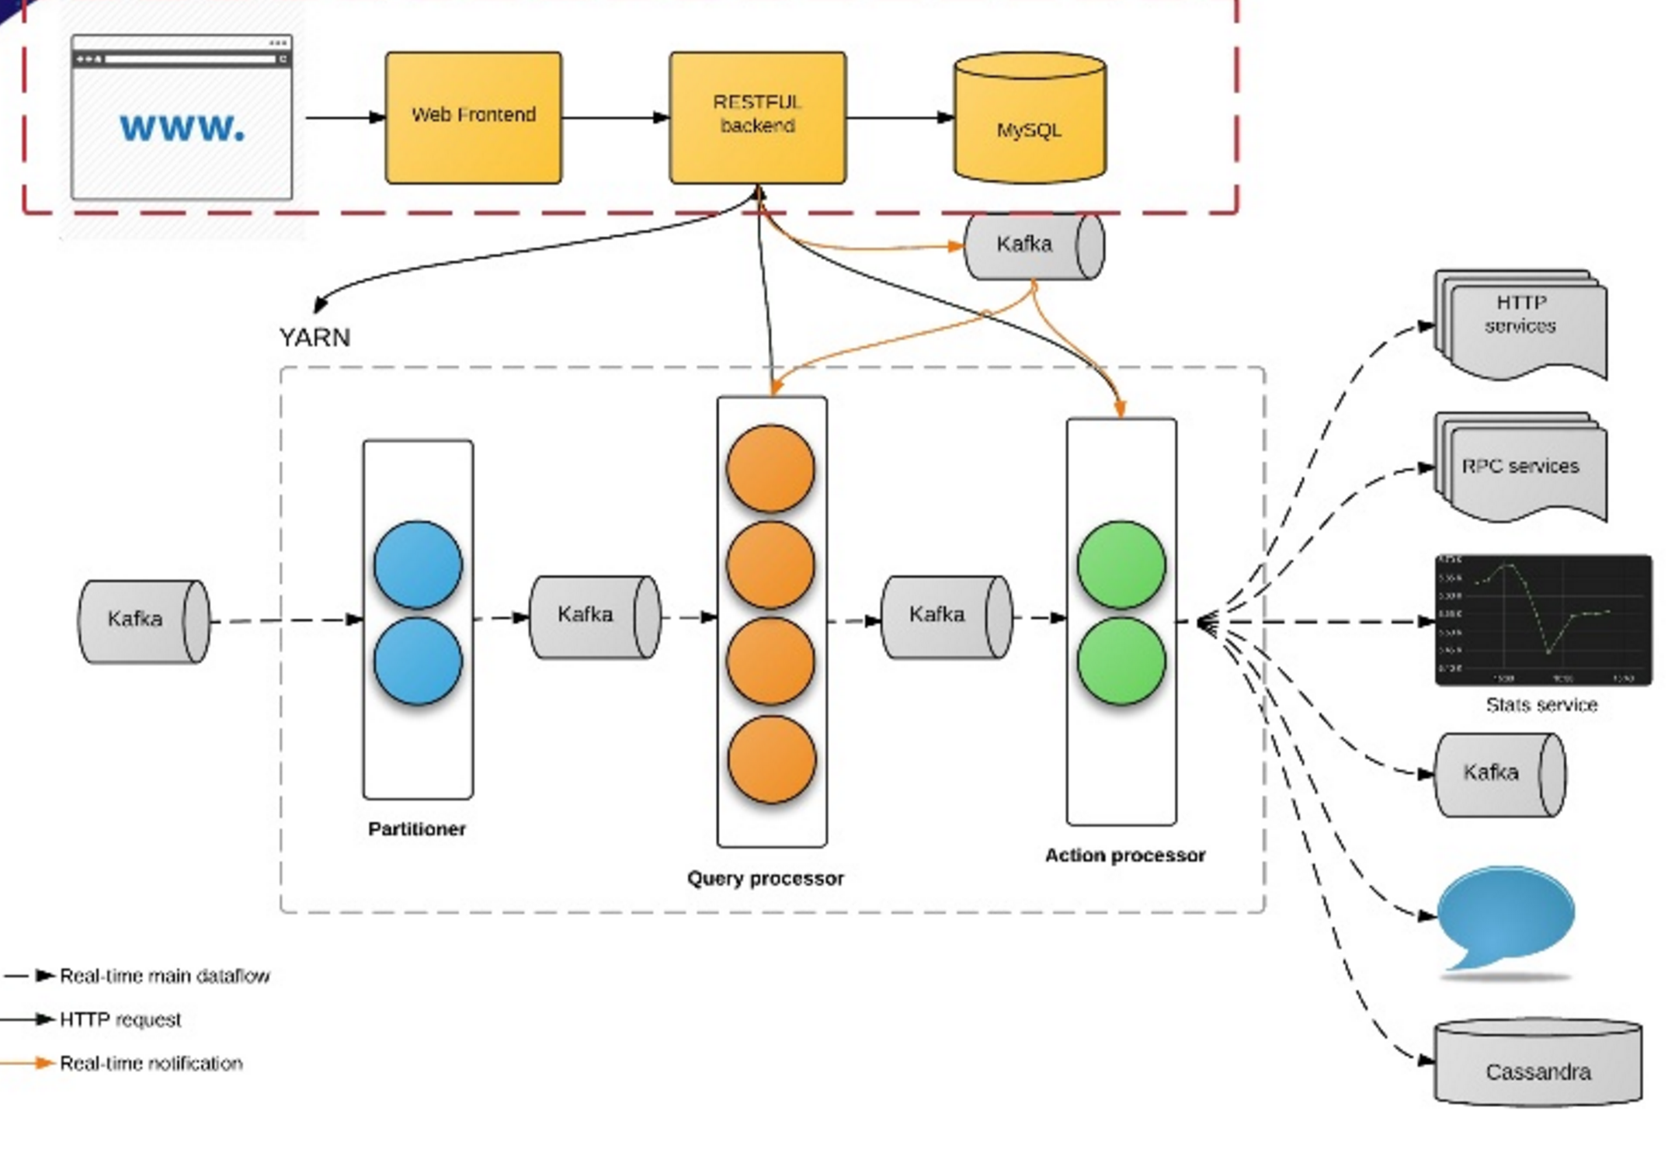
Siddhi at Uber

Slide 34
Siddhi at Uber
100+ production apps
30 billion messages / day
Fraud, anomaly detection
Marketing, promotion
Monitoring, feedback
Real time analytics and visualization
https://freo.me/siddhi-uber

Slide 35
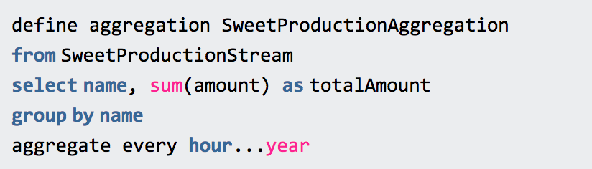
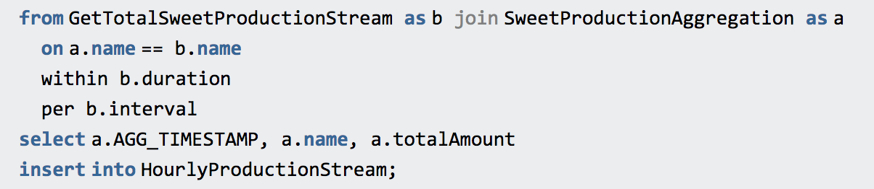
Long-running aggregation

Slide 36
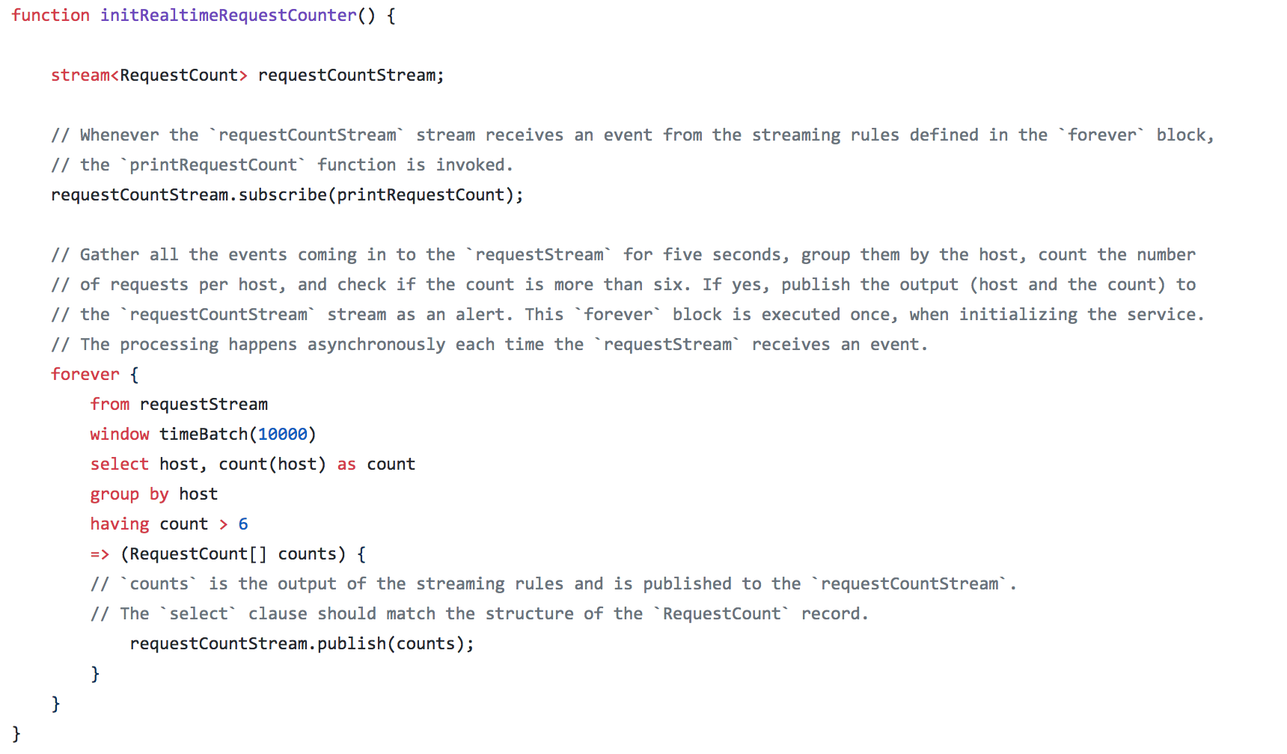
Streaming in Ballerina

Slide 37
Summary
Realtime processing is hard
Requires large memory and state
The lambda architecture splits the problem into batch and realtime challenges
Multiple approaches:
Pure Streaming
Micro-batch
CEP

Slide 38
Questions?

